Slide 1




SRM
Institute of Science and Technology
SUB : AI - mini projet
Title : ‘GESTURE VOLUME CONTROL BY HAND’
Team members
GEVARIYA MEET B (RA1911028010131)
YASHWANTH MANCHIKANTI (RA1911028010135)
SAMPATH KUMAR (RA1911028010138)
MOHANA CHAITANYA(RA1911028010141)
PRATIKSHA GHOSH (RA1911028010142)
Section : J1
Code : 18CSC305J
Supervised By
Mr.M.THENMOZHI

Slide 2

INTRODUCTION
The project introduces an application using computer vision for Hand gesture recognition. A camera records a live video stream, from which a snapshot is taken with the help of interface. The system is trained for each type of count hand gestures (one, two, three, four, and five) at least once. After that a test gesture is given to it and the system tries to recognize it. A research was carried out on a number of algorithms that could best differentiate a hand gesture. It was found that the diagonal sum algorithm gave the highest accuracy rate. In the preprocessing phase, a self-developed algorithm removes the background of each training gesture. After that the image is converted into a binary image and the sums of all diagonal elements of the picture are taken. This sum helps us in differentiating and classifying different hand gestures.

Slide 3
Aim & Objectives
This prompted my interest so I planned to make a software system that could recognize human gestures through computer vision, which is a sub field of artificial intelligence. The purpose of my software through computer vision was to program a computer to "understand" a scene or features in an image.
Hand detection is related to the location of the presence of a hand in a still image or sequence of images i.e. moving images. In case of moving sequences it can be followed by tracking of the hand in the scene but this is more relevant to the applications such as sign language. The underlying concept of hand detection is that human eyes can detect objects which machines cannot with that much accuracy as that of a human. From a machine point of view it is just like a man fumble around with his senses to find an object.

Slide 4
Module description
V-STUDIO (Python IDE)
OPEN-CV (Module)
Numpy
Hand trackingModule (Module)
Pycaw (module)
Camera (Physical Hardware)

Slide 5
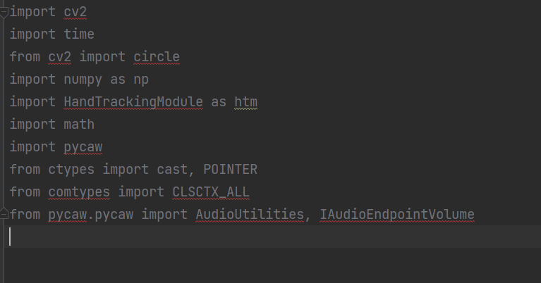
Coding area(imported library)

Slide 6
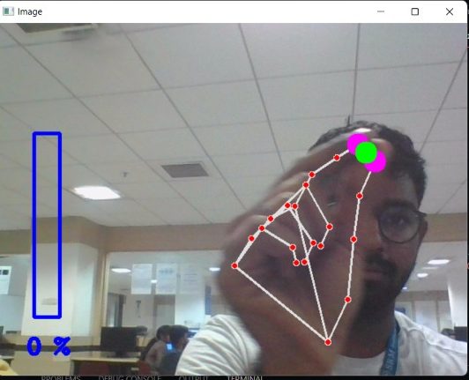
Output as a python IDE

Slide 7
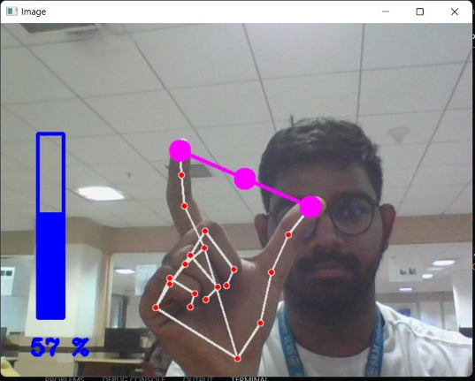

Slide 8
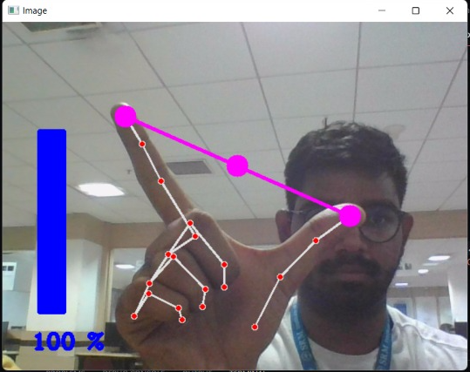

Slide 9
Conclusion and Future work
The system could also be made smart to be trained for only one or two gestures rather than all and then made ready for testing. This will require only a few changes in the current interface code, which were not performed due to the shortage of time. One time training constraint for real time system can be removed if the algorithm is made efficient to work with all skin types and light conditions which seems impossible by now altogether. Framing with COG (Centre of gravity) to control orientation factor could make this system more perfect for real application. The system‟s speed for preprocessing could be improved if the code is developed in VC/VC.Net

Slide 10




GEVARIYA MEET B
YASHWANTH MANCHIKANTI
SAMPATH KUMAR
MOHANA CHAITANYA
PRATIKSHA GHOSH

